Slide 1
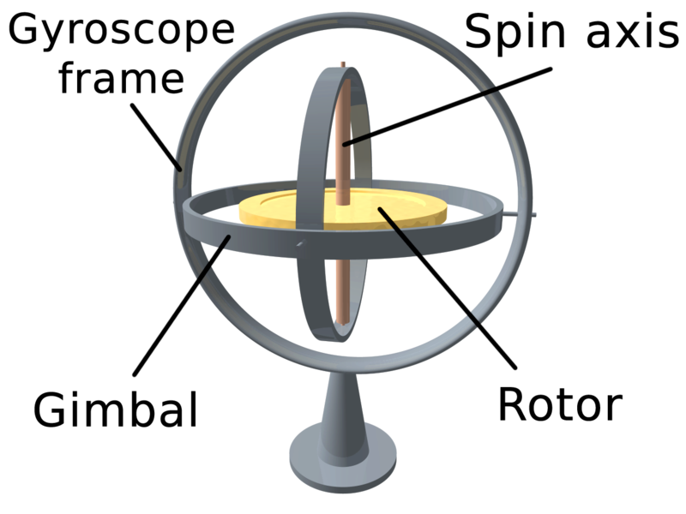
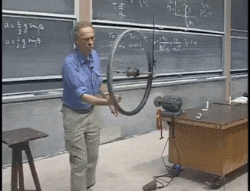
Gyroscope
A gyroscope is a device for measuring or maintaining orientation, based on the principles of angular momentum.
A mechanical gyroscope is essentially a spinning wheel or disk whose axle is free to take any orientation.
This orientation changes much less in response to a given external torque than it would without the large angular momentum associated with the gyroscope's high rate of spin.

Slide 2
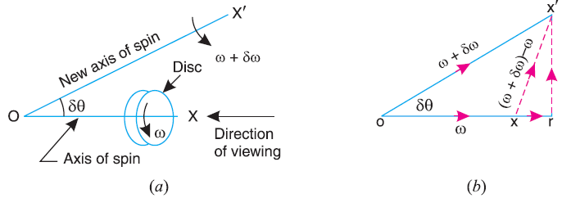
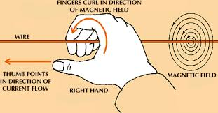
Precessional Angular Motion
(Vectorial representation of angular motion)
We know that the angular acceleration is the rate of change of angular velocity with respect to time.
It is a vector quantity and may be represented by drawing a vector diagram with the help of right hand screw rule.
Consider a disc, as shown in Fig. (a), revolving or spinning about the axis OX (known as axis of spin) in anticlockwise when seen from the front, with an angular velocity in a plane at right angles to the paper.

Slide 3
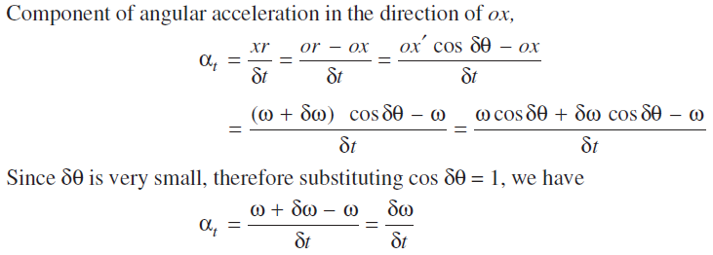
After a short interval of time t, let the disc be spinning about the new axis of spin OX (at an angle δθ ) with an angular velocity (ω +δω).
Using the right hand screw rule, initial angular velocity of the disc ω is represented by vector ox; and the final angular velocity of the disc (ω +δω ) is represented by vector ox’ as shown in Fig. (b).
The vector xx’ represents the change of angular velocity in time δt i.e. the angular acceleration of the disc. This may be resolved into two components, one parallel to ox and the other perpendicular to ox.

Slide 4
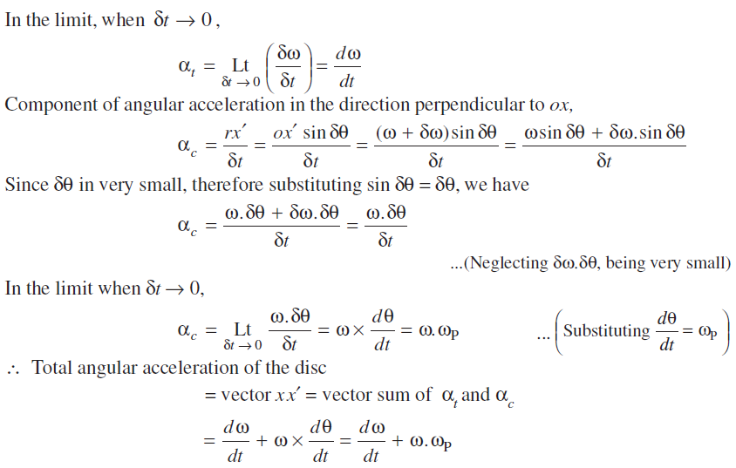

Slide 5
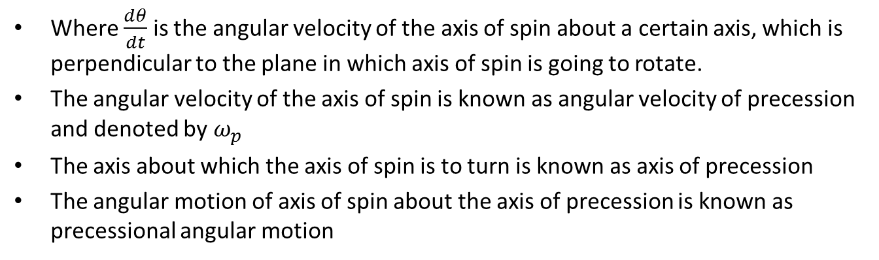
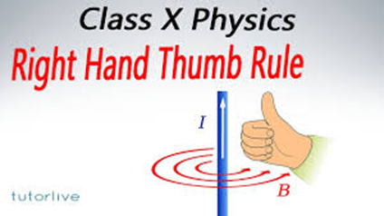

Slide 6
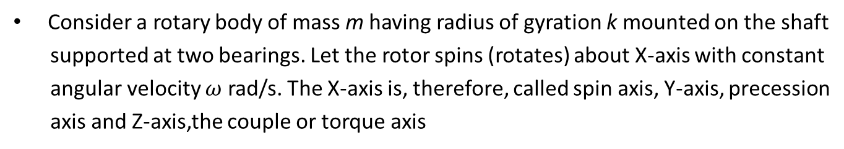
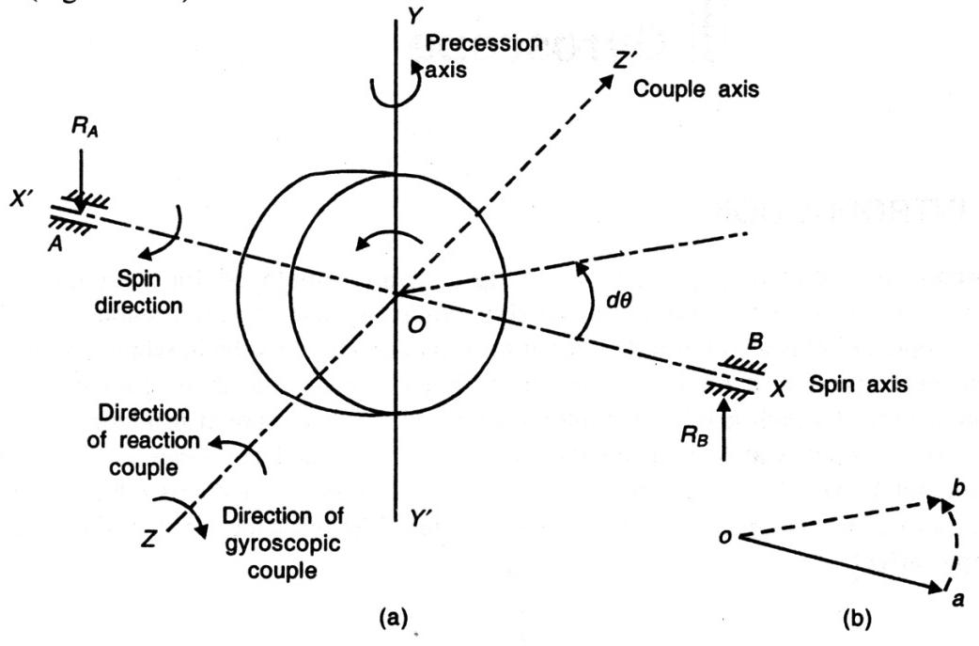
GYROSCOPIC COUPLE

Slide 7
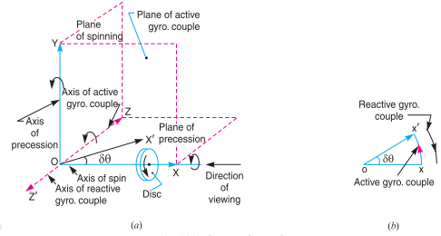

Slide 8
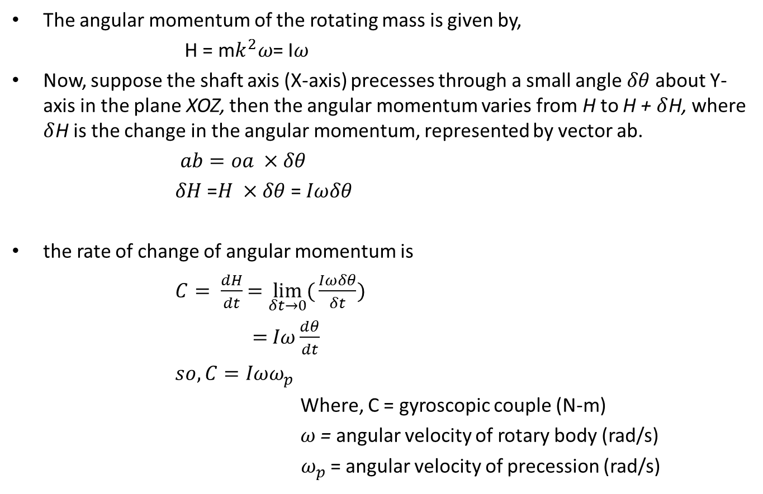

Slide 9
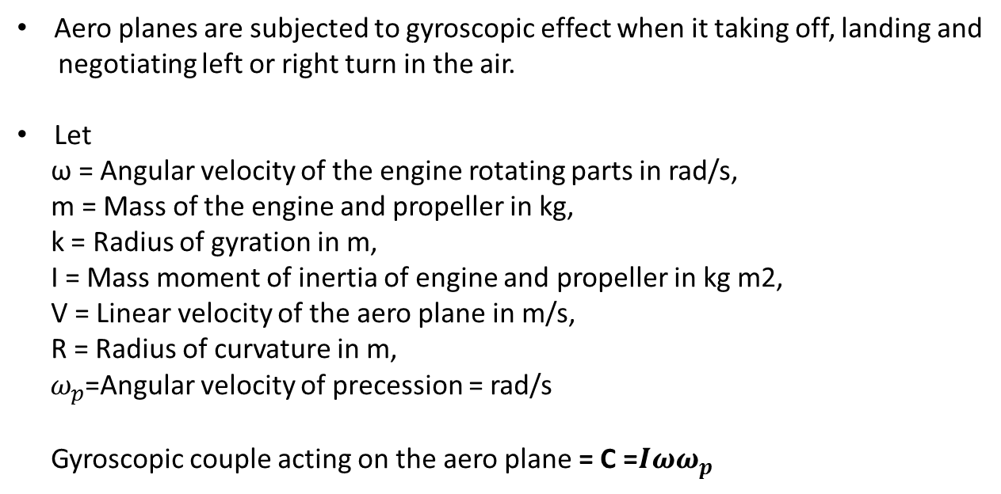

Effect of the Gyroscopic Couple on an Aero-plane

Slide 10
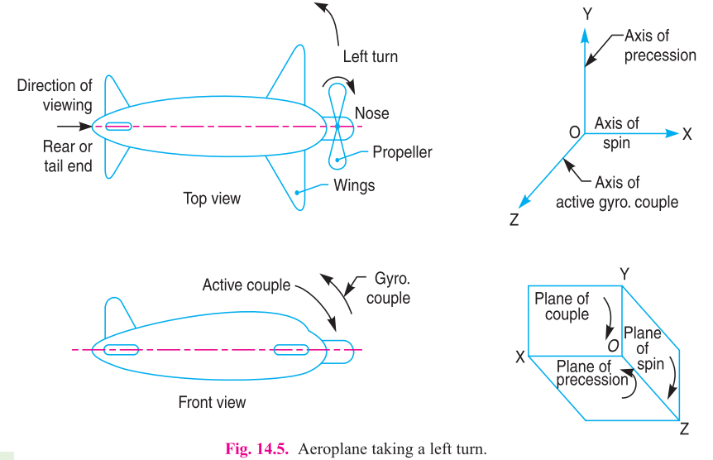
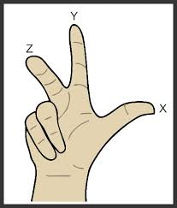
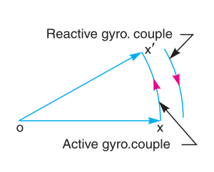

Slide 11
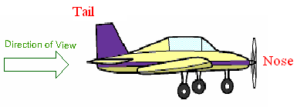
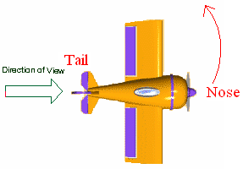
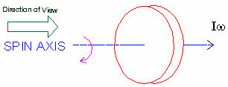
Case (i): PROPELLER rotates in CLOCKWISE direction when seen from rear end and Aeroplane turns towards LEFT

Slide 12
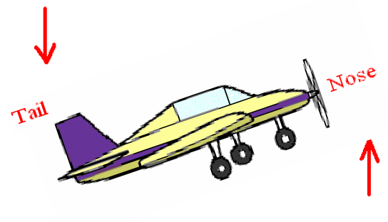
According to the analysis, the reactive gyroscopic couple tends to dip the tail and raise the nose of aeroplane.

Slide 13
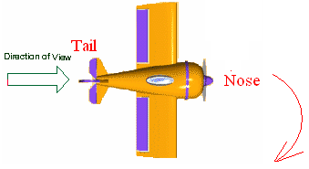
Case (ii): PROPELLER rotates in CLOCKWISE direction when seen from rear end and Aeroplane turns towards RIGHT

Slide 14
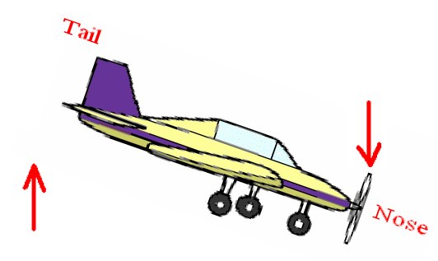
According to the analysis, the reactive gyroscopic couple tends to raise the tail and dip the nose of aeroplane.

Slide 15
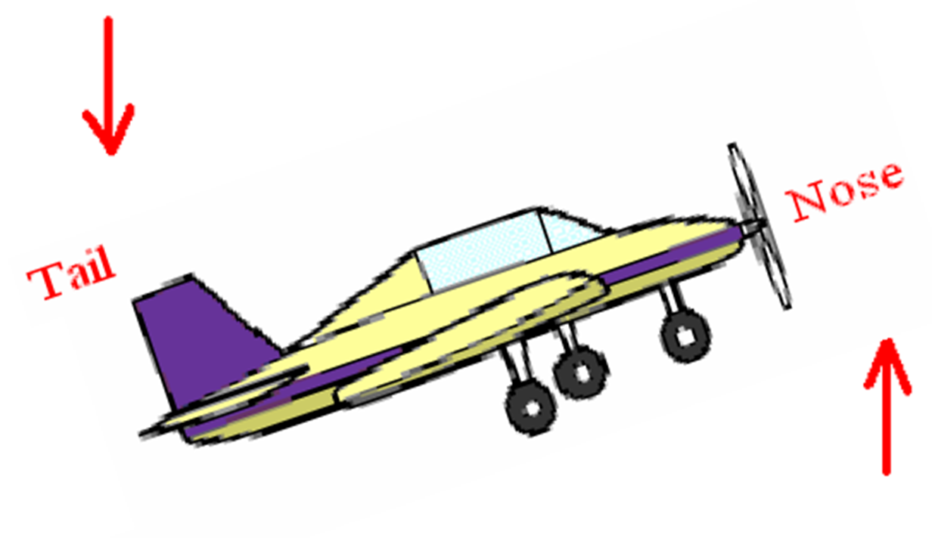
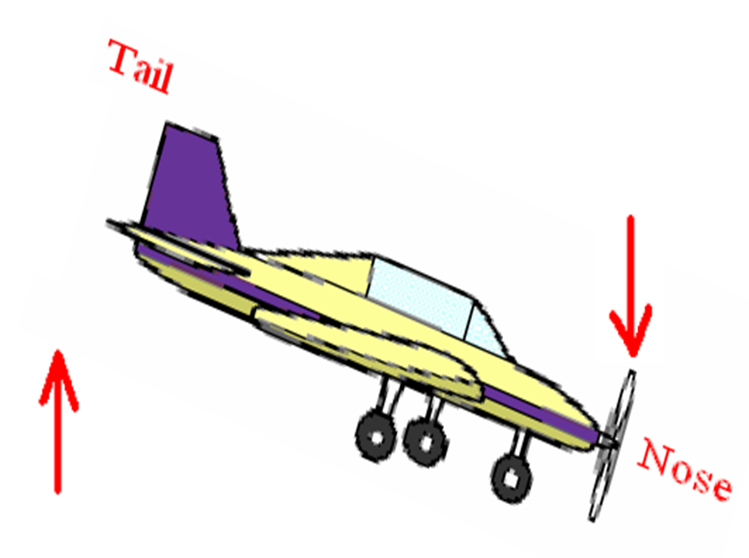

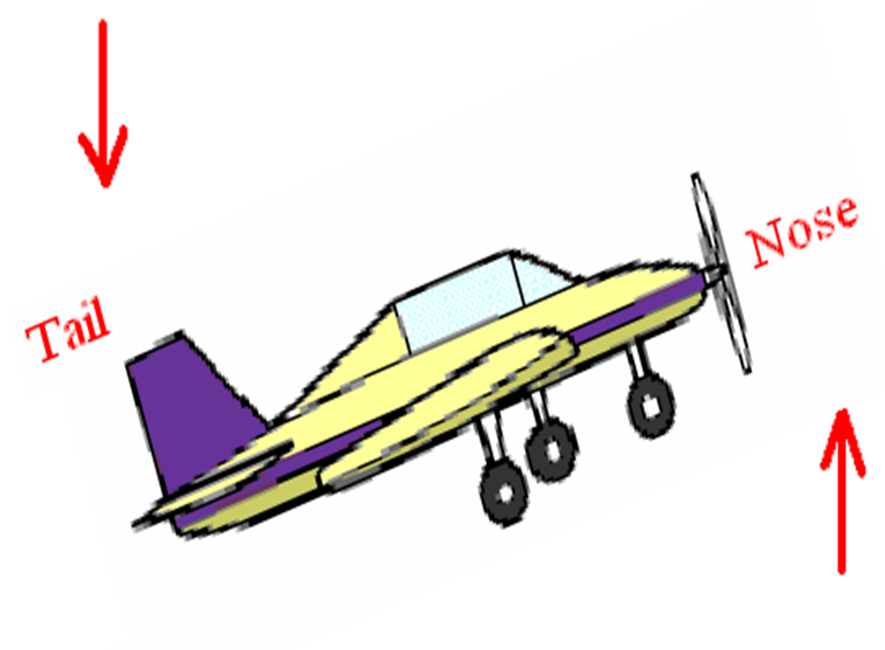
Case (i): PROPELLER rotates in CLOCKWISE direction when seen from rear end and Aeroplane turns towards LEFT
Case (ii): PROPELLER rotates in CLOCKWISE direction when seen from rear end and Aeroplane turns towards RIGHT
Case (iii): PROPELLER rotates in ANTICLOCKWISE direction when seen from rear end and Aeroplane turns towards LEFT
Case (iv): PROPELLER rotates in ANTICLOCKWISE direction when seen from rear end and Aeroplane turns towards RIGHT

Slide 16
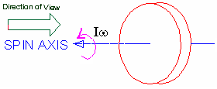
Case (iii): PROPELLER rotates in ANTICLOCKWISE direction when seen from rear end and Aeroplane turns towards LEFT

Slide 17
According to the analysis, the reactive gyroscopic couple tends to raise the tail and dip the nose of aeroplane

Slide 18
Case (iv): PROPELLER rotates in ANTICLOCKWISE direction when seen from rear end and Aeroplane turns towards RIGHT

Slide 19
The analysis shows, the reactive gyroscopic couple tends to raise the nose and dip the tail of aeroplane

Slide 20
Case (i): PROPELLER rotates in CLOCKWISE direction when seen from rear end and Aeroplane turns towards LEFT
Case (ii): PROPELLER rotates in CLOCKWISE direction when seen from rear end and Aeroplane turns towards RIGHT
Case (iii): PROPELLER rotates in ANTICLOCKWISE direction when seen from rear end and Aeroplane turns towards LEFT
Case (iv): PROPELLER rotates in ANTICLOCKWISE direction when seen from rear end and Aeroplane turns towards RIGHT

Slide 21
Problem : An aeroplane makes a complete half circle of 50 metres radius, towards left, when flying at 200 km per hr. The rotary engine and the propeller of the plane has a mass of 400 kg and a radius of gyration of 0.3 m. The engine rotates at 2400 r.p.m. clockwise when viewed from the rear. Find the gyroscopic couple on the aircraft and state its effect on it.
Solution:
Given data : R = 50 m ; v = 200 km/hr = 55.6 m/s ; m = 400 kg ; k = 0.3 m ; N = 2400 r.p.m. or ω = 2 π × 2400/60 = 251 rad/s

Slide 22
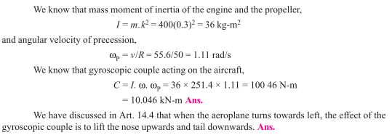

Slide 23
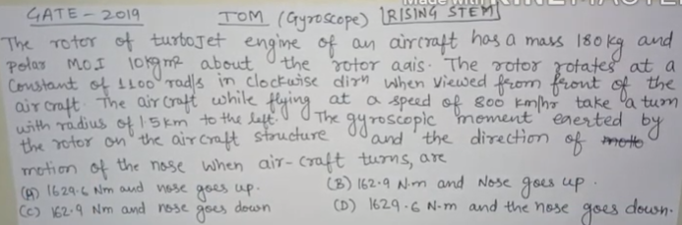
Ans-D

Slide 24
GYROSCOPIC EFFECT ON SHIP
Gyroscope is used for stabilization and directional control of a ship sailing in the rough sea. A ship, while navigating in the rough sea, may experience the following three different types of motion:
(i) Steering—The turning of ship in a curve while moving forward
(ii) Pitching—The movement of the ship up and down from horizontal position in a vertical plane about transverse axis
(iii)Rolling—Sideway motion of the ship about longitudinal axis.

Slide 25
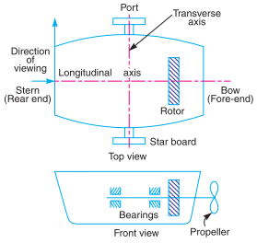
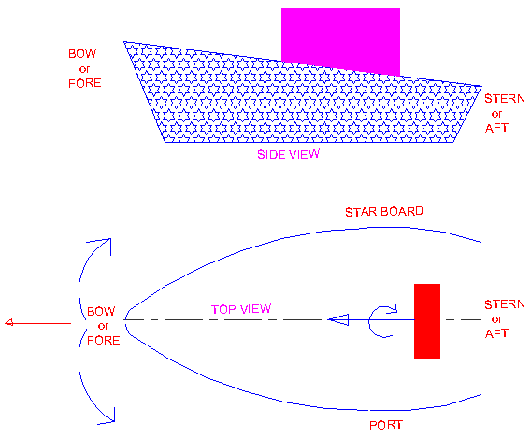
Ship Terminology
(i) Bow – It is the fore end of ship
(ii) Stern – It is the rear end of ship
(iii) Starboard – It is the right hand side of the ship looking in the direction of motion
(iv) Port – It is the left hand side of the ship looking in the direction of motion

Slide 26
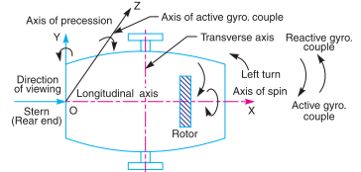
Gyroscopic effect on Steering of ship
Naval ship taking a left turn

Slide 27
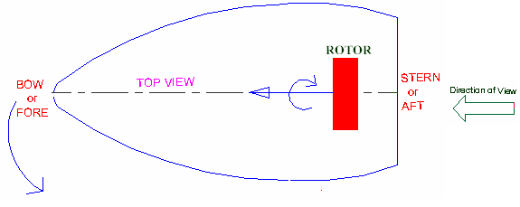
Gyroscopic effect on Steering of ship
(i) Left turn with clockwise rotor
When ship takes a left turn and the rotor rotates in clockwise direction viewed from stern, the gyroscopic couple act on the ship is analyzed in the following way.

Slide 28
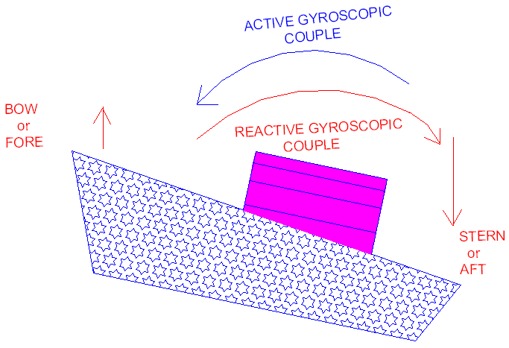
From the above analysis, the couple acts over the ship between stern and bow. This reaction couple tends to raise the front end (bow) and lower the rear end (stern) of the ship

Slide 29
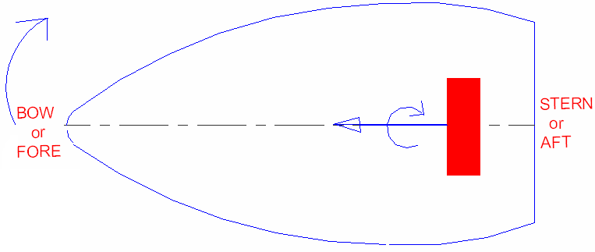
(ii) Right turn with clockwise rotor
When ship takes a right turn and the rotor rotates in clockwise direction viewed from stern

Slide 30
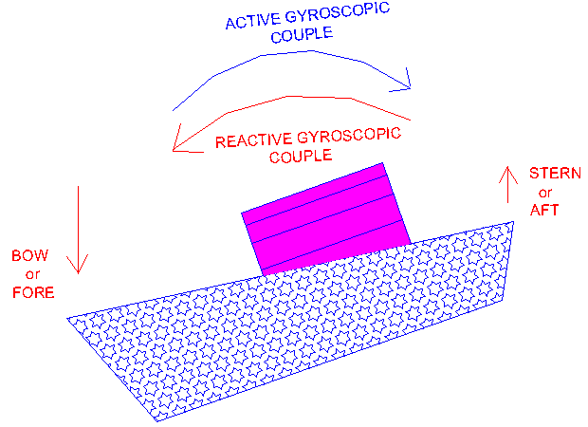
The couple acts in vertical plane, means between stern and bow. Now the reaction couple tends to lower the bow of the ship and raise the stern.

Slide 31
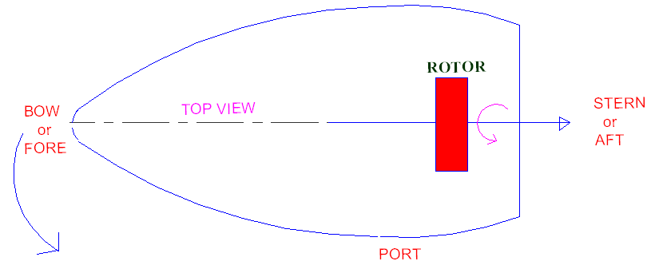
(iii) Left turn with anticlockwise rotor
When ship takes a left turn and the rotor rotates in anticlockwise direction viewed from stern

Slide 32
The couple acts over the ship is between stern and bow. This reaction couple tends to press or dip the front end (bow) and raise the rear end (stern) of the ship.

Slide 33
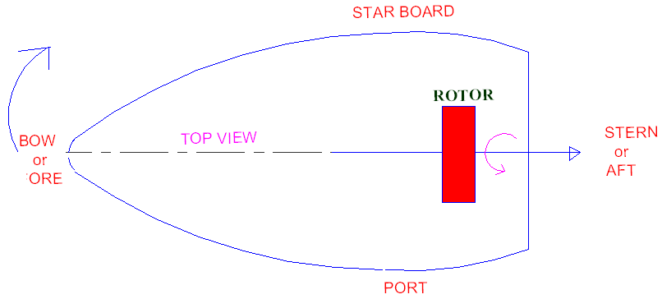
(iv) Right turn with anticlockwise rotor
When ship takes a right turn and the rotor rotates in anticlockwise direction viewed from stern

Slide 34
The gyroscopic couple act on the ship is according to Figure. Now, the reaction couple tends to raise the bow of the ship and dip the stern.

Slide 35
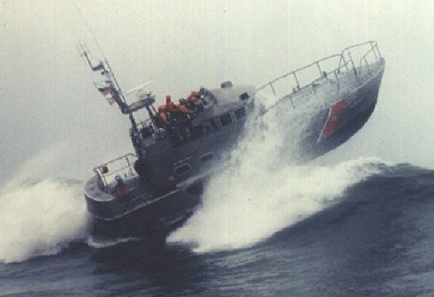
Gyroscopic effect on Pitching of ship
The pitching motion of a ship generally occurs due to waves which can be approximated as sine wave. During pitching, the ship moves up and down from horizontal position in vertical plane

Slide 36
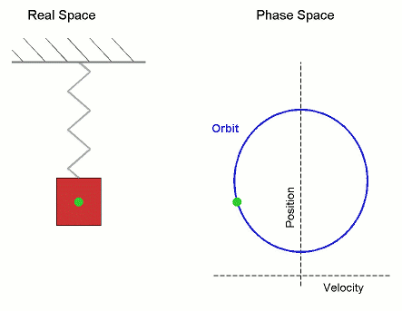
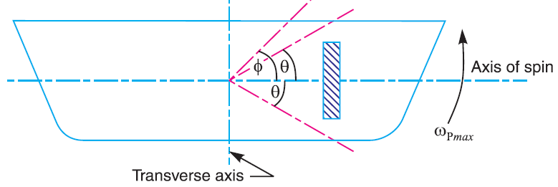
Pitching is the movement of a complete ship up and down in a vertical plane about transverse axis, as shown in Fig.
In this case, the transverse axis is the axis of precession. The pitching of the ship is assumed to take place with simple harmonic motion i.e. the motion of the axis of spin about transverse axis is simple harmonic.

Slide 37
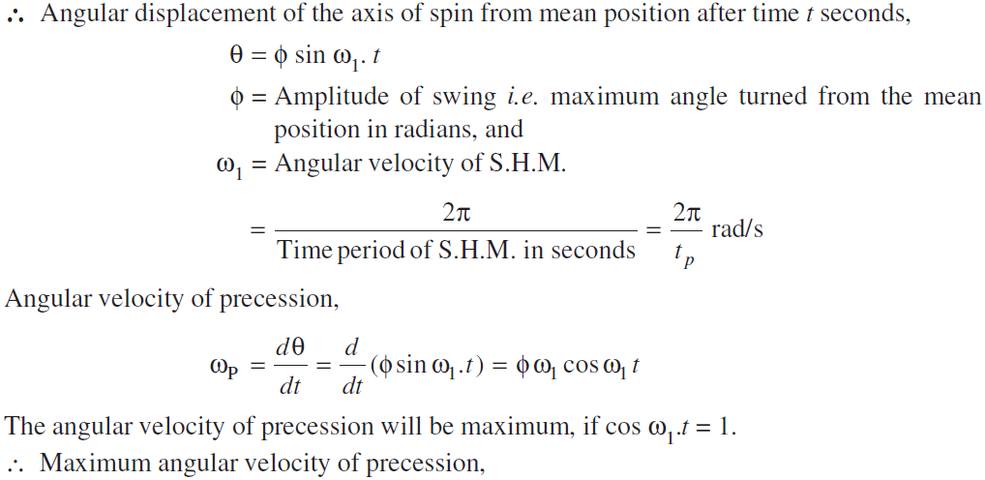
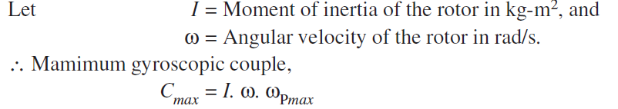

Slide 38
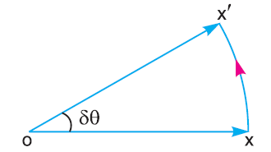
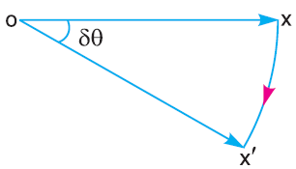
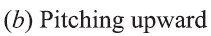
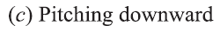
When the pitching is upward, the effect of the reactive gyroscopic couple, as shown in Fig.(b), will try to move the ship toward star-board.
On the other hand, if the pitching is downward, the effect of the reactive gyroscopic couple, as shown in Fig.(c), is to turn the ship towards port side.

Slide 39
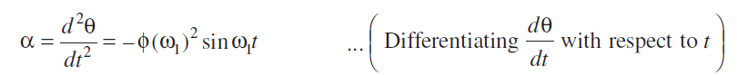
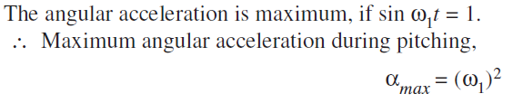
Notes :
The effect of the gyroscopic couple is always given on specific position of the axis of spin i.e. whether it is pitching downwards or upwards.
The maximum gyroscopic couple tends to shear the holding-down bolts.
The angular acceleration during pitching is given by

Slide 40
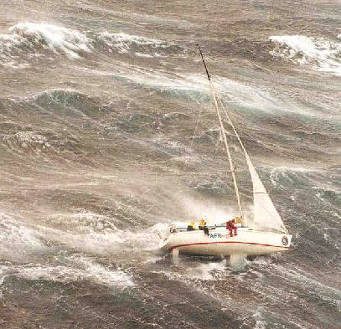
Gyroscopic effect on Rolling of ship
The axis of the rotor of a ship is mounted along the longitudinal axis of ship and therefore, there is no precession of this axis. Thus, no effect of gyroscopic couple on the ship frame is formed when the ship rolls

Slide 41
Problem: The turbine rotor of a ship has a mass of 3500 kg. It has a radius of gyration of 0.45 m and a speed of 3000 r.p.m. clockwise when looking from stern. Determine the gyroscopic couple and its effect upon the ship:
1. when the ship is steering to the left on a curve of 100 m radius at a speed of 36 km/h.
2. when the ship is pitching in a simple harmonic motion, the bow falling with its maximum velocity. The period of pitching is 40 seconds and the total angular displacement between the two extreme positions of pitching is 12 degrees.
Solution:
Given data : m = 3500 kg ; k = 0.45 m; N = 3000 r.p.m. or ω = 2π × 3000/60 = 314.2 rad/s

Slide 42
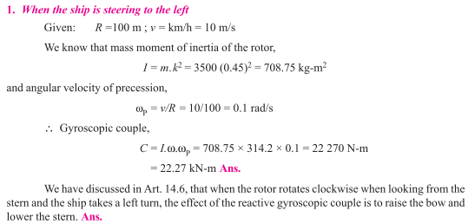

Slide 43


Slide 44
Problem : A ship propelled by a turbine rotor which has a mass of 5 tonnes and a speed of 2100 r.p.m. The rotor has a radius of gyration of 0.5 m and rotates in a clockwise direction when viewed from the stern. Find the gyroscopic effects in the following conditions:
1. The ship sails at a speed of 30 km/h and steers to the left in a curve having 60 m radius.
2. The ship pitches 6 degree above and 6 degree below the horizontal position. The bow is descending with its maximum velocity. The motion due to pitching is simple harmonic and the periodic time is 20 seconds.
3. The ship rolls and at a certain instant it has an angular velocity of 0.03 rad/s clockwise when viewed from stern. Determine also the maximum angular acceleration during pitching. Explain how the direction of motion due to gyroscopic effect is determined in each case.
Solution:
Given : m = 5 t = 5000 kg ; N = 2100 r.p.m. or ω = 2π × 2100/60 = 220 rad/s ; k = 0.5 m

Slide 45



Slide 46


Slide 47

Ans- 100.5 KN-m

Slide 48


Stability of Four Wheeled Vehicle
Stable condition
Unstable Condition

Slide 49


Stability of a Four Wheel Drive Moving in a Curved Path
Consider the four wheels A, B, C and D of an automobile locomotive taking a turn towards left as shown in Fig.
The wheels A and C are inner wheels, whereas B and D are outer wheels. The centre of gravity (C.G.) of the vehicle lies vertically above the road surface.

Slide 50

A little consideration will show, that the weight of the vehicle (W) will be
equally distributed over the four wheels
which will act downwards.
The reaction between each wheel and the road surface of the same magnitude will act upwards.
Therefore Road reaction over each wheel, = W/4 = m.g /4 newtons

Slide 51

Let us now consider the effect of the gyroscopic couple and centrifugal couple on the vehicle.
The positive sign is used when the wheels and rotating parts of the engine rotate in the same direction. If the rotating parts of the engine revolves in opposite direction, then negative sign is used.

Slide 52
Due to the gyroscopic couple, vertical reaction on the road surface will be produced.
The reaction will be vertically upwards on the outer wheels and vertically downwards on the inner wheels.
Let the magnitude of this reaction at the two outer or inner wheels be P newtons. Then
P × x = C or P = C/x
Vertical reaction at each of the outer or inner wheels, P /2 = C/ 2x
Note: when rotating parts of the engine rotate in opposite directions, then –ve sign is used, i.e. net gyroscopic couple,
C = C_{W} – C_{E,}
When C _{E} > C_{W}, then C will be –ve. Thus the reaction will be vertically downwards on the outer wheels and vertically upwards on the inner wheels.

Slide 53


2. Effect of the centrifugal couple
Since the vehicle moves along a curved path, therefore centrifugal force will act outwardly at the centre of gravity of the vehicle.
The effect of this centrifugal force is also to overturn the vehicle.
We know that centrifugal force,
This overturning couple is balanced by vertical reactions, which are vertically upwards on the outer wheels and vertically downwards on the inner wheels.

Slide 54

A little consideration will show that when the vehicle is running at high speeds, P_{I} may be zero or even negative. This will cause the inner wheels to leave the ground thus tending to overturn the automobile. In order to have the contact between the inner wheels and the ground, the sum of P/2 and Q/2 must be less than W/4.

Slide 55

Stability of Two Wheeler negotiating a turn
Let
m = Mass of the vehicle and its rider in kg,
W = Weight of the vehicle and its rider in newtons = m.g,
h = Height of the centre of gravity of the vehicle and rider,
rW = Radius of the wheels,
R = Radius of track or curvature,
IW = Mass moment of inertia of each wheel,
IE = Mass moment of inertia of the rotating parts of the engine,
ωW = Angular velocity of the wheels,
ωE = Angular velocity of the engine rotating parts,
G = Gear ratio = ωE / ωW,
v = Linear velocity of the vehicle = ωW × rW,
θ = Angle of heel. It is inclination of the vehicle to the vertical for equilibrium
Fig. shows a two wheeler vehicle taking left turn over a curved path. The vehicle is inclined to the vertical for equilibrium by an angle θ known as angle of heel.

Slide 56




Slide 57




It is observed that, when the wheels move over the curved path, the vehicle is always inclined at an angle θ with the vertical plane as shown in Fig. This angle is known as ‘angle of heel’.
Gyroscopic Couple,
Note: When the engine is rotating in the same direction as that of wheels, then the positive
sign is used in the above equation. However, if the engine rotates in opposite direction to
wheels, then negative sign is used.

Slide 58

The gyroscopic couple will act over the vehicle outwards i.e., in the anticlockwise
direction when seen from the front of the two wheeler. This couple tends to
overturn/topple the vehicle in the outward direction as shown in Fig.

Slide 59



2. Effect of Centrifugal Couple
Centrifugal force,
Centrifugal Couple,
The Centrifugal couple will act over the two wheeler outwards i.e., in the anticlockwise direction when seen from the front of the two wheeler. This couple tends to overturn/topple the vehicle in the outward direction

Slide 60



total Over turning couple: C = Cg + Cc

Slide 61


For the stability, overturning couple must be equal to balancing couple,
Therefore,
from the above equation, the value of angle of heel (θ) may be determined,
so that the vehicle does not skid. Also, for the given value of θ, the maximum
vehicle speed in the turn with out skid may be determined

